Slide 1
İstanbul data scıence academy
Bitirme Projesi
Nur Topel

Slide 2







Slide 3
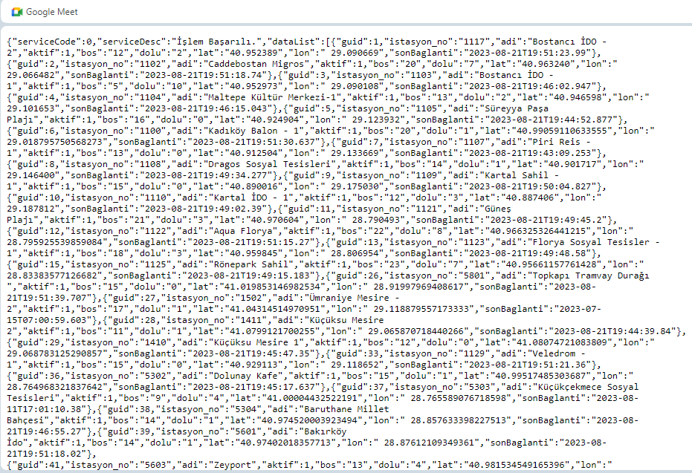
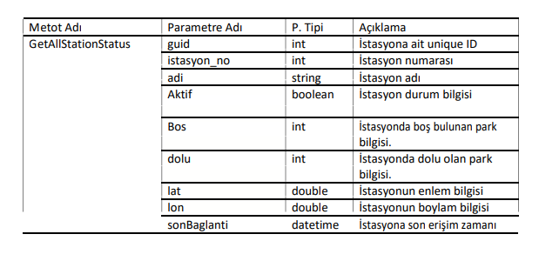
ISBIKE Datası

Slide 4
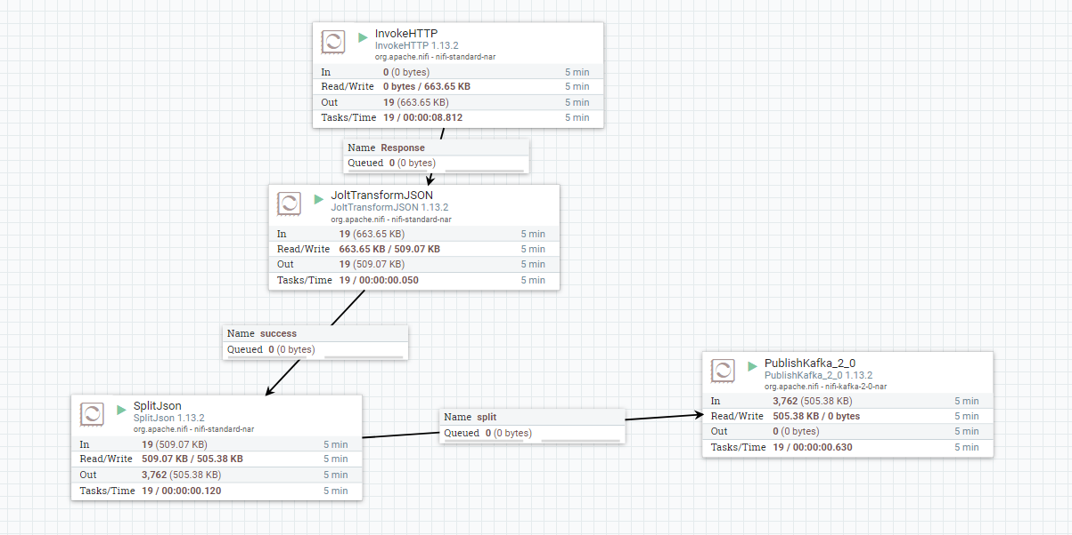
Apache Nifi

Slide 5
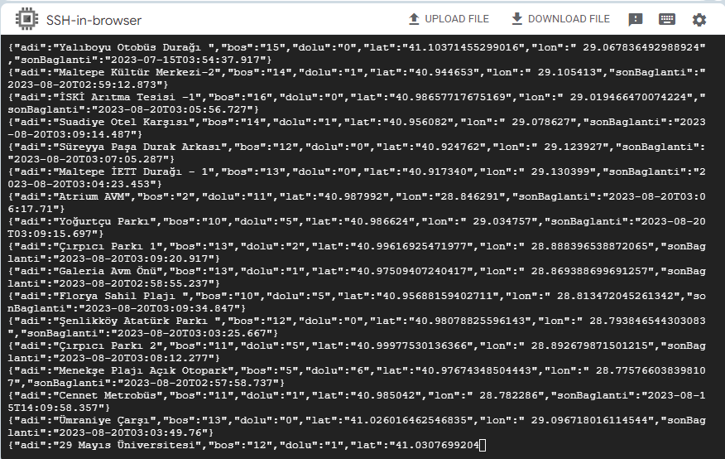
Apache Kafka
sudo apt-get install openjdk-8-jdk
wget https://archive.apache.org/dist/kafka/3.3.1/kafka_2.12-3.3.1.tgz
tar -xzvf kafka_2.12-3.3.1.tgz
cd kafka_2.12-3.3.1
sudo nohup bin/zookeeper-server-start.sh config/zookeeper.properties &
sudo nohup bin/kafka-server-start.sh config/server.properties &
sudo bin/kafka-topics.sh --create --topic ornek --bootstrap-server localhost:9092
sudo bin/kafka-topics.sh --delete --topic ornek --bootstrap-server localhost:9092
sudo bin/kafka-console-consumer.sh --topic ornek --from-beginning --bootstrap-server localhost:9092
sudo bin/kafka-console-producer.sh --topic ornek --bootstrap-server localhost:9092
---------------------------------------------------------------------------------------------------
cd /opt/kafka/
sudo nohup bin/zookeeper-server-start.sh config/zookeeper.properties &
sudo nohup bin/kafka-server-start.sh config/server.properties &
sudo bin/kafka-topics.sh --create --topic ornek --bootstrap-server localhost:9092
sudo bin/kafka-console-consumer.sh --topic ornek --from-beginning --bootstrap-server localhost:9092
sudo bin/kafka-console-producer.sh --topic ornek --bootstrap-server localhost:9092
sudo bin/kafka-topics.sh --bootstrap-server=localhost:9092 –list
sudo bin/kafka-topics.sh --bootstrap-server localhost:9092 --delete --topic ornek

Slide 6
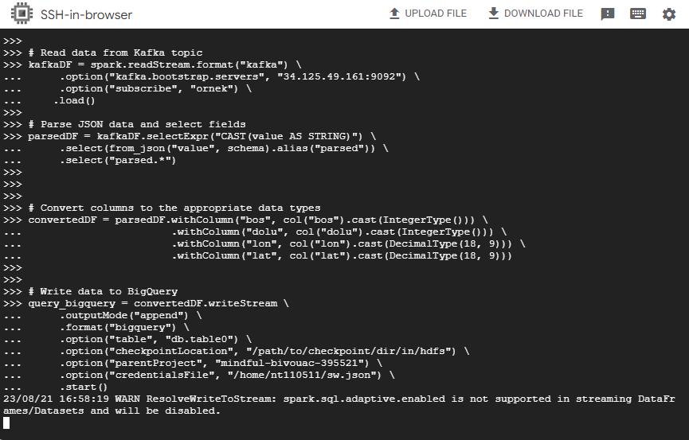
DataProc & Spark
from pyspark.sql import SparkSession
from pyspark.sql.functions import from_json, col
from pyspark.sql.types import StructType, StructField, StringType, IntegerType, FloatType, TimestampType, DecimalType
# Spark oturumu başlat
spark = SparkSession.builder.appName("KafkaToBigQuery").getOrCreate()
# Bucket ve proje bilgileri
bucket = "bucket_json02"
spark.conf.set("temporaryGcsBucket", bucket)
spark.conf.set("parentProject", "mindful-bivouac-395521")
# JSON Data şemasını belirle
schema = StructType([
StructField("adi", StringType()),
StructField("bos", StringType()),
StructField("dolu", StringType()),
StructField("lon", StringType()),
StructField("lat", StringType()),
StructField("sonBaglanti", TimestampType())
])
# Kafka Topic’ten veri al
kafkaDF = spark.readStream.format("kafka") \
.option("kafka.bootstrap.servers", "34.125.49.161:9092") \
.option("subscribe", "ornek") \
.load()
# Parse JSON data and select fields
parsedDF = kafkaDF.selectExpr("CAST(value AS STRING)") \
.select(from_json("value", schema).alias("parsed")) \
.select("parsed.*")
# Doğru Veri Türüne Çevir
convertedDF = parsedDF.withColumn("bos", col("bos").cast(IntegerType())) \
.withColumn("dolu", col("dolu").cast(IntegerType())) \
.withColumn("lon", col("lon").cast(DecimalType(18, 9))) \
.withColumn("lat", col("lat").cast(DecimalType(18, 9)))
# Datayı BigQuery’e yazdır
query_bigquery = convertedDF.writeStream \
.outputMode("append") \
.format("bigquery") \
.option("table", "db.table0") \
.option("checkpointLocation", "/path/to/checkpoint/dir/in/hdfs") \
.option("parentProject", "mindful-bivouac-395521") \
.option("credentialsFile", "/home/nt110511/sw.json") \
.start()
query_bigquery.awaitTermination()

Slide 7
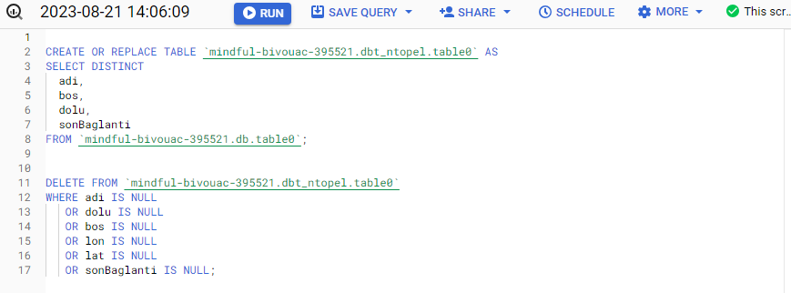
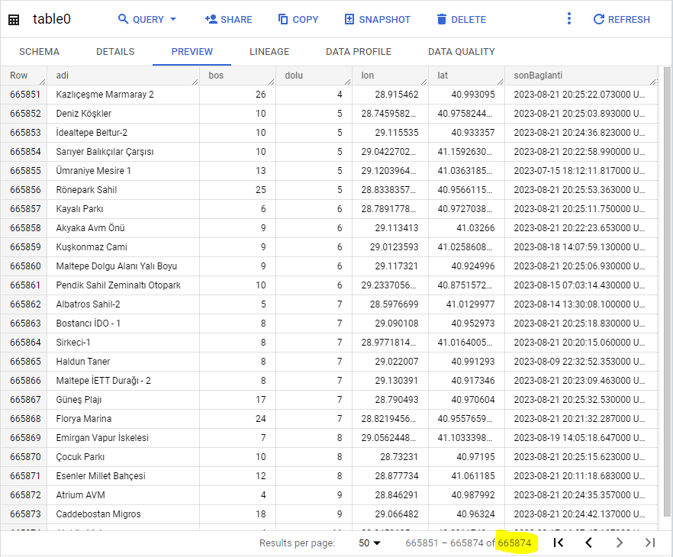
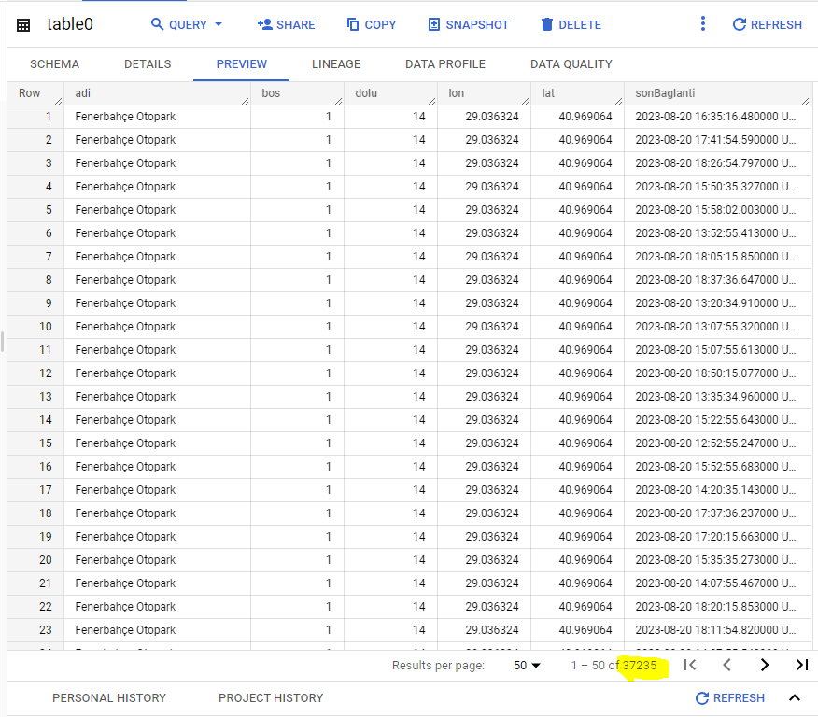
BigQuery

Slide 8
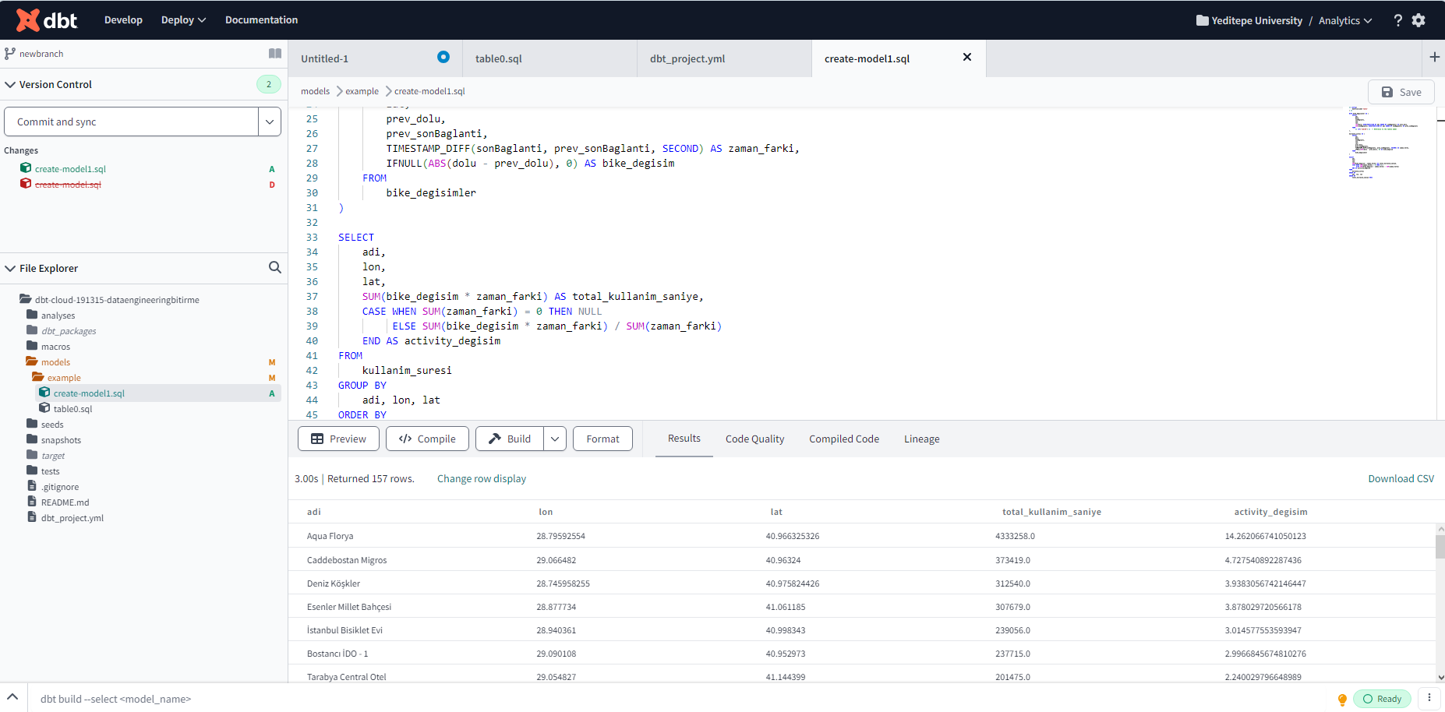
DBT

Slide 9
DBT table1.sql
DBT create_model.sql
{{ config(
materialized='table'
) }}
WITH bike_degisimler AS (
SELECT
adi,
dolu,
sonBaglanti,
lon,
lat,
LAG(dolu) OVER(PARTITION BY adi ORDER BY sonBaglanti) AS prev_dolu,
LAG(sonBaglanti) OVER(PARTITION BY adi ORDER BY sonBaglanti) AS prev_sonBaglanti
FROM
{{ ref('table0') }} -- Reference to the table1 model
),
kullanim_suresi AS (
SELECT
adi,
dolu,
sonBaglanti,
lon,
lat,
prev_dolu,
prev_sonBaglanti,
TIMESTAMP_DIFF(sonBaglanti, prev_sonBaglanti, SECOND) AS zaman_farki,
IFNULL(ABS(dolu - prev_dolu), 0) AS bike_degisim
FROM
bike_degisimler
)
SELECT
adi,
lon,
lat,
SUM(bike_degisim * zaman_farki) AS total_kullanim_saniye,
CASE WHEN SUM(zaman_farki) = 0 THEN NULL
ELSE SUM(bike_degisim * zaman_farki) / SUM(zaman_farki)
END AS activity_degisim
FROM
kullanim_suresi
GROUP BY
adi, lon, lat
ORDER BY
total_kullanim_saniye DESC
{{ config(
materialized='table'
) }}
SELECT * FROM dbt_ntopel.table0 WHERE dolu > 0

Slide 10
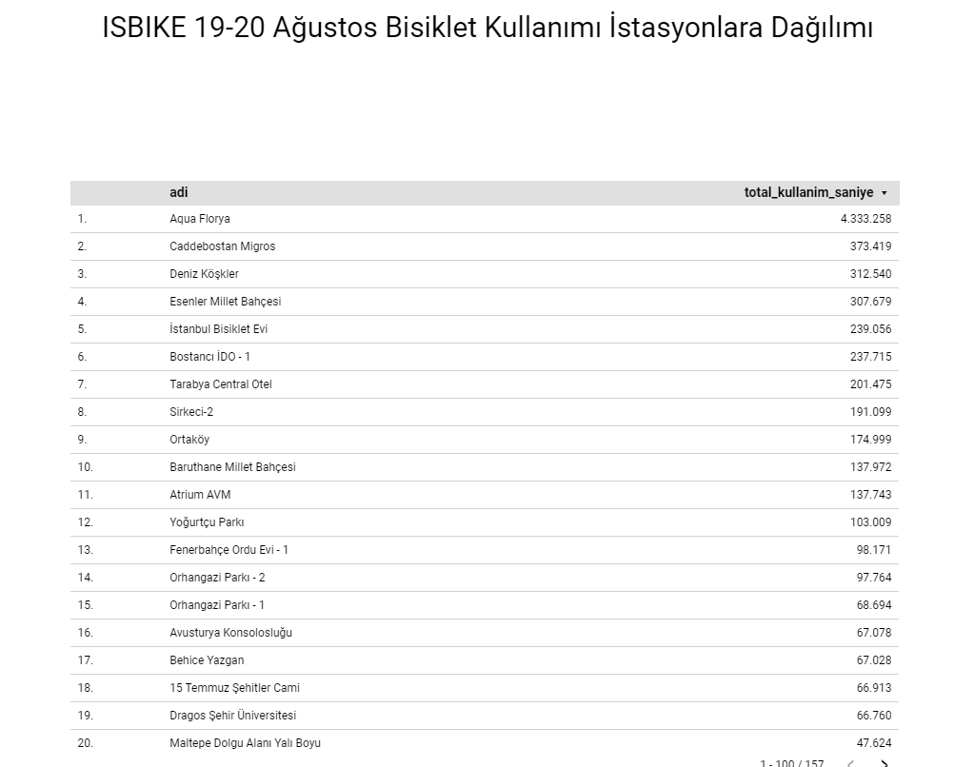
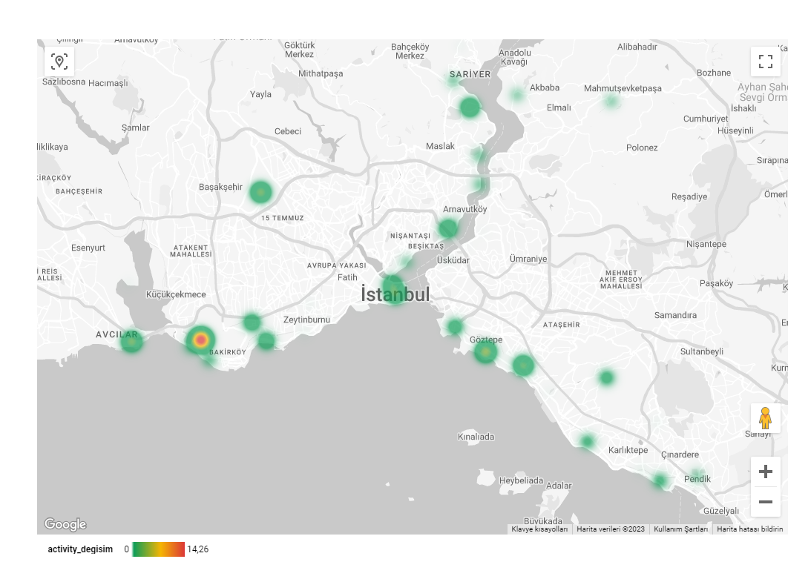
Looker Studio

